Slide 1
SPSD Training For New Staff C Practice 1
Dongli Cao, SPSD

Slide 2
Content
Keyword
Data type
Operator
Control flow
Stack and Heap
Function execution

Slide 3
1 . Keyword

Slide 4
Keyword
What are C language keywords?
reserved words
A keyword is a word that has been used by the C language editing tool itself and cannot be used for other purposes
The number of C language keywords?
32+6+7

Slide 5
Keyword
ANSI C:
auto | break | case | char | const | continue | default | do
double | else | enum | extern | float | for | goto | if
Int | long | register | return | short | signed | sizeof | static
struct | switch | typedef | union | unsigned | void | volatile | while
ISO C99:
inline | restrict | _Bool | _Complex | _Imaginary | _Pragma
ISO C11:
_Alignas | _Alignof | _Atomic | _Static_assert | _Noreturn | _Thread_local | _Generic

Slide 6
Keyword
data type:
signed unsigned short long int
float double char
enum struct union typedef void
(_Bool _Imaginary _Complex)
type specifier/qualifiers:
const volatile
(restrict inline)
storage class:
auto static extern register
operator:
sizeof
control:
goto return break continue
if else switch case default
do while for

Slide 7
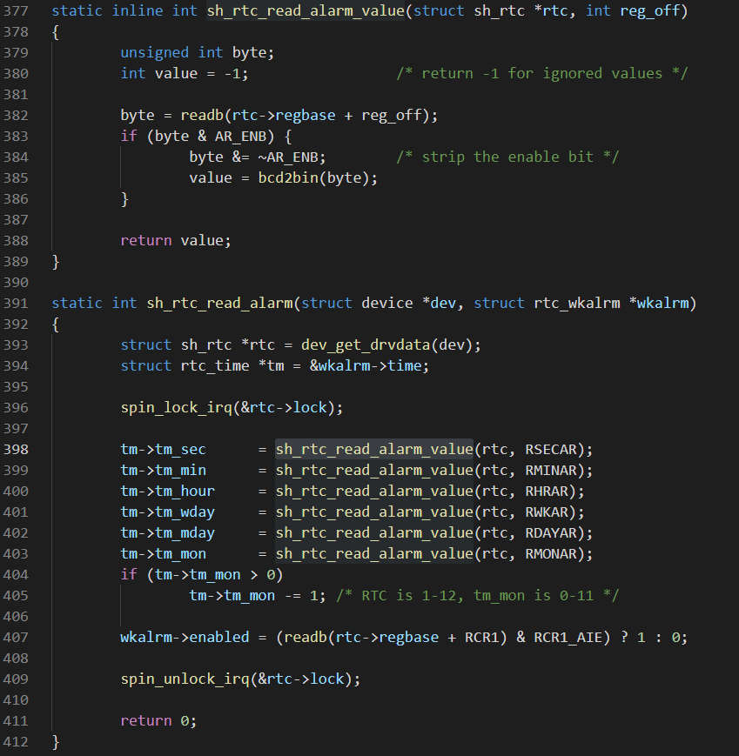
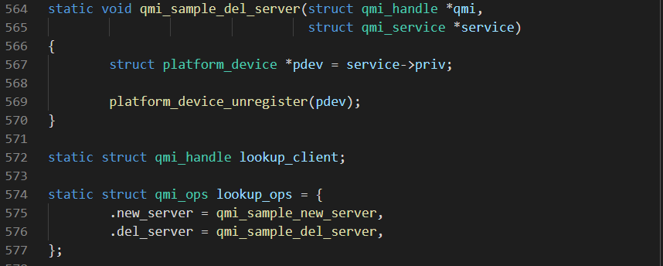
Keyword

Slide 8
2 . Data type

Slide 9
Data Type
Variable and Data type
A variable is a storage area in memory. The definition of the data type determines the size of this storage area.
What are the C language data type?

Slide 10
Data Type
short
int
long
long long
integer type
Base Type
char type(char)
float
double
long double
floating-point type
Data Type
enum type
array type
struct type
union type
Constructed Type
Pointer type(*)
void type(void)

Slide 11
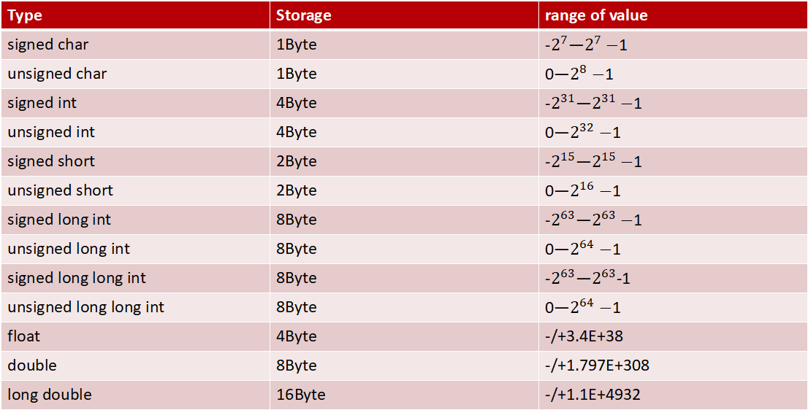
Data Type(64 PC,64 System)
Type | Storage | range of value
signed char | 1Byte
unsigned char | 1Byte
signed int | 4Byte
unsigned int | 4Byte
signed short | 2Byte
unsigned short | 2Byte
signed long int | 8Byte
unsigned long int | 8Byte
signed long long int | 8Byte
unsigned long long int | 8Byte
float | 4Byte | -/+3.4E+38
double | 8Byte | -/+1.797E+308
long double | 16Byte | -/+1.1E+4932
Notes:
In software development, integration is the process of incorporating changes like refactored code, new features, or bug fixes into the existing codebase.

Slide 12
Data Type（type conversion）
Characters, integers, and floating-point operations can be mixed
Implicit Type Conversions
C automatically converts any intermediate values to the proper type so that the expression can be evaluated without losing any significance. This automatic conversion is known as Implicit type conversion.
Explicit Type Conversions
(type-name) expression.
The expression may be a constant variable or an expression.
Both automatic casts and cast casts are temporary casts for the purpose of the operation. The results of the casts are stored in a temporary memory space without changing the original type or value of the data
Notes:
In software development, integration is the process of incorporating changes like refactored code, new features, or bug fixes into the existing codebase.

Slide 13
3. Operator

Slide 14
Operator
Arithmetic operators
Relational operators
Bitwise operators
Logical operator
Assignment operators
Other operators
Notes:
A deployment pipeline is an automated system that runs increasingly rigorous test suites against a build as a series of sequential stages.

Slide 15
Arithmetic operator
Arithmetic operator:
+ | - | * | / | % | ++ | --
Relational operator:
< | > | <= | >= | == | !=
Bitwise operators:
& | | | ^ | ~ | << | >>
Logical operator:
&& | || | !
Assignment operator:
= | +=,-=,*=,/=,%=,<<=, >>=, &=, ^=, |=
Notes:
https://blog.csdn.net/CrankZ/article/details/81545439
https://www.synopsys.com/blogs/software-security/agile-cicd-devops-difference/

Slide 16
Other operators
Pointer operators : & and *
Member Selection Operators: . And ->
Conditional operators: Exp1 ? Exp2 : Exp3;
sizeof operators: sizeof
parenthesis operator : {} () []

Slide 17
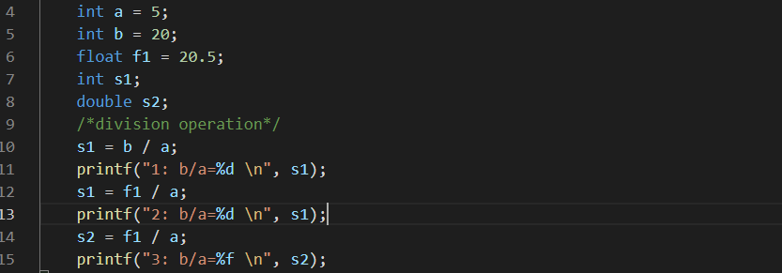
Operators
1: b/a=4
2: b/a=4
3: b/a=4.100000

Slide 18
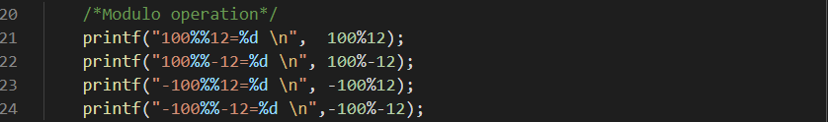
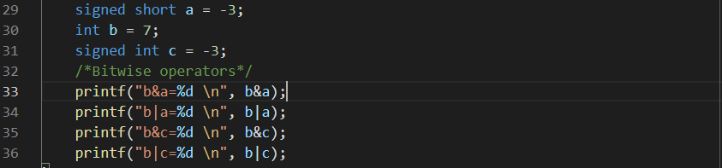
Operators
100%12=4
100%-12=4
-100%12=-4
-100%-12=-4
b&a=5
b|a=-1
b&c=5
b|c=-1

Slide 19
Arithmetic operator
For a division operation:
if both the divisor and the dividend are integers, then the result is an integer.
If either divisor or dividend is a float type, the result is also a double float type.
Modulo division operations must have integer data on both sides
The remainder can be either positive or negative, depending on the integer to the left of %
Notes:
https://blog.csdn.net/CrankZ/article/details/81545439
https://www.synopsys.com/blogs/software-security/agile-cicd-devops-difference/

Slide 20
Bitwise operators
When &,|and^ are used with operands of different sizes, the shorter operand is increased in bit size to match the size of the larger operand.
When extending signed numbers, the original leftmost bit is reproduced in the additional bits that are added to the number.

Slide 21
Logical operator
The evaluation feature for the && and || operators that makes the evaluation of an expression stop as soon as it is determined that an expression is false id known as short-circuit evaluation.
Parentheses can be used to alter the assigned operator priority.
For example：
a && b&&c： If a is true (non-0), you need to check for b, and if both a and b are true, you need to check for c 。
a||b||c： As long as A is true (non-0), we do not need to judge B and C. B only if A is false; If both a and b are false, then C must be determined.

Slide 22
Operator Precedence and Associativity
The operators of same precedence are evaluated either from ‘left to right’ or from ‘right to left’, depending on the level. This is known as the associativity property of an operator.
Refer to: http://c.biancheng.net/view/161.html

Slide 23
4. Control flow

Slide 24
Control flow
Selection statement：
If switch, case
Loop statement：
While do-while for

Slide 25
Selection statement
Two types:
if switch,case
1. The difference between if and switch?
2. What shall be noted when using if and switch statement?
3. How to choose to use if or switch?

Slide 26
if
if(expression) {
statement;
}
if(expression) {
statement 1;
} else {
statement 2;
}

Slide 27
if
if(expression1) statement 1
else if(expression2) statement 2
…..
else statement n
An if-else statement can contain other if-else statements.

Slide 28
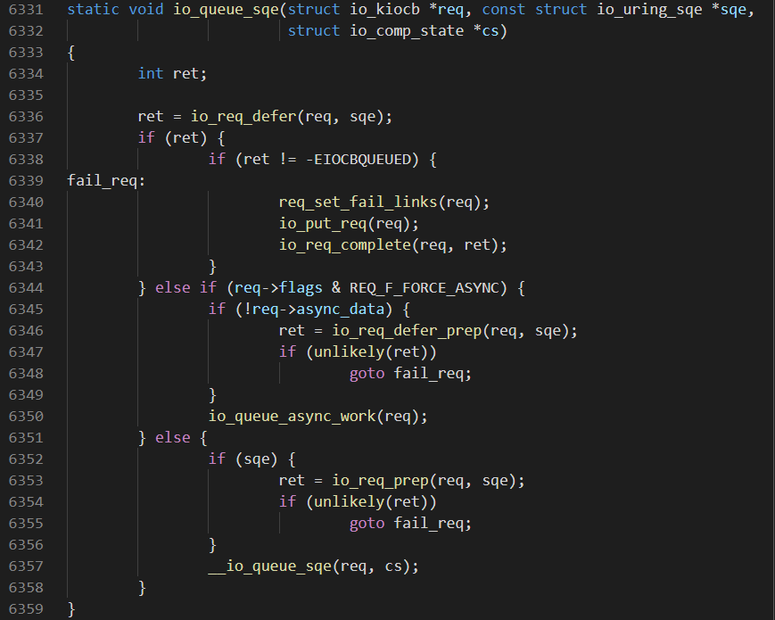
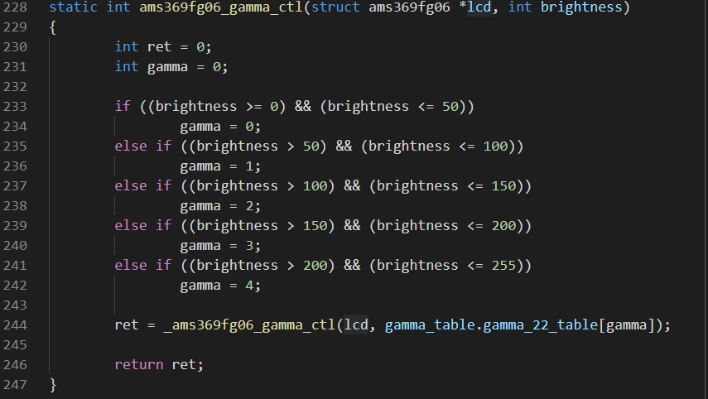
if

Slide 29
Switch case
switch(expression) {
case constant expression 1: statement 1 break；
case constant expression 2: statement2 break；
……
case constant expression n：statement n break;
default：statement n+1 break;
}
The switch statement is a multiway selection
statement; Program execution is transferred to
the first matching case and continue though
the end of the switch statement unless an
optional break statement is encountered.

Slide 30
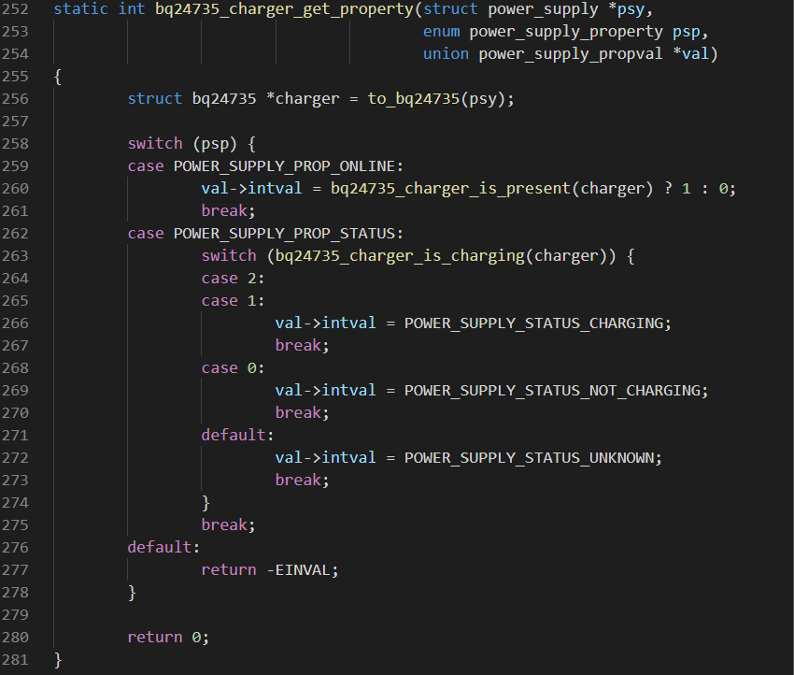
Switch

Slide 31
Loop statement
Three types:
while do-while for
Loop control:
Break
A break statement forces an immediate exit from while, switch, for and do-while statements only.
Continue
The continue applies to loops only. When a continue statement is encountered in a loop, the next iteration of the loop begins immediately.

Slide 32
While
while(expression) {
statement;
}

Slide 33
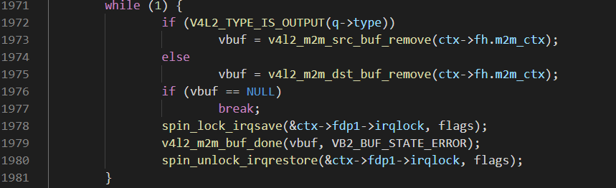
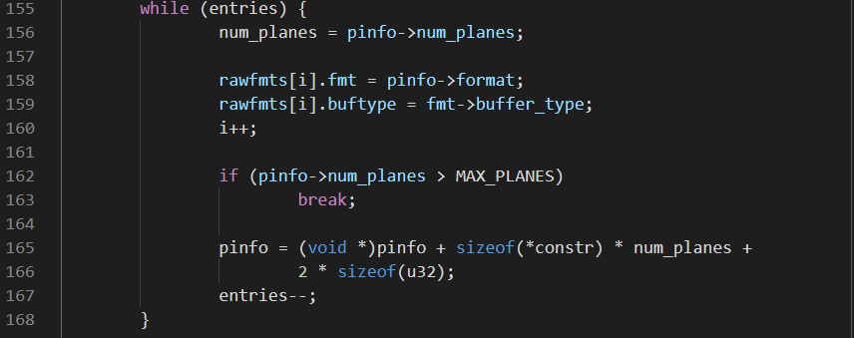
While

Slide 34
Do While
do {
statement；
} while (expression)

Slide 35
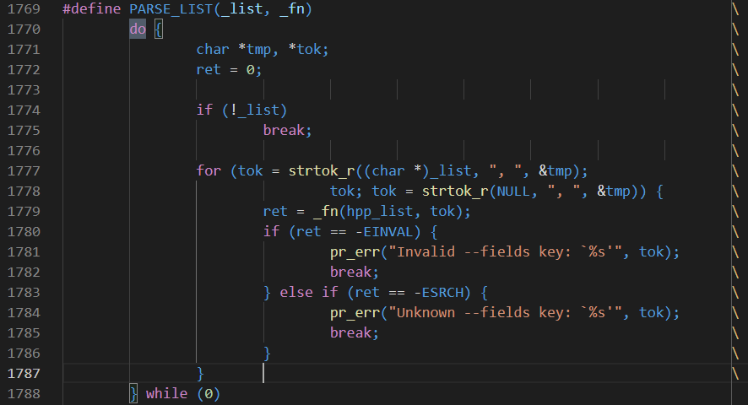
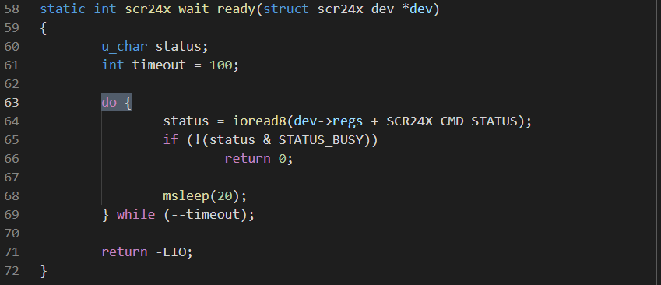
Do While

Slide 36
For
for(Expression1， Expression2， Expression3) Operational statement;
This statement does not require that any of the items in parentheses be present or that they actually be used for initializing or altering the values in the expression statement.

Slide 37
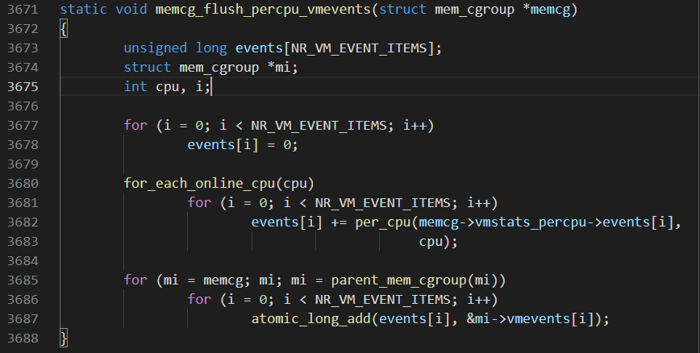
For

Slide 38
Goto
goto provides an unconditional transfer of control to some other statement in a program.
goto label: label is any unique name chosen according to the rules for creating variable names.

Slide 39
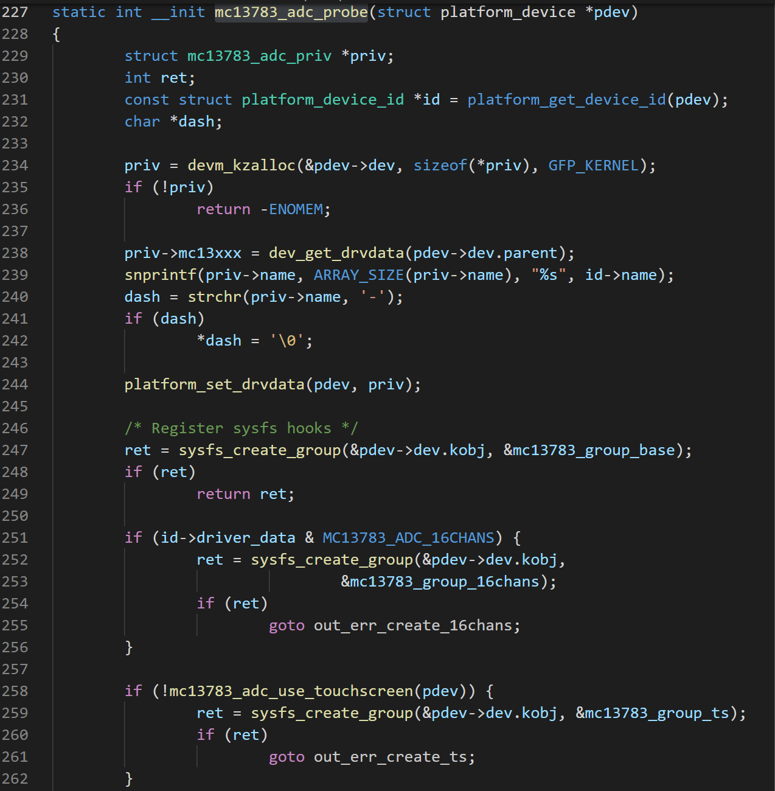
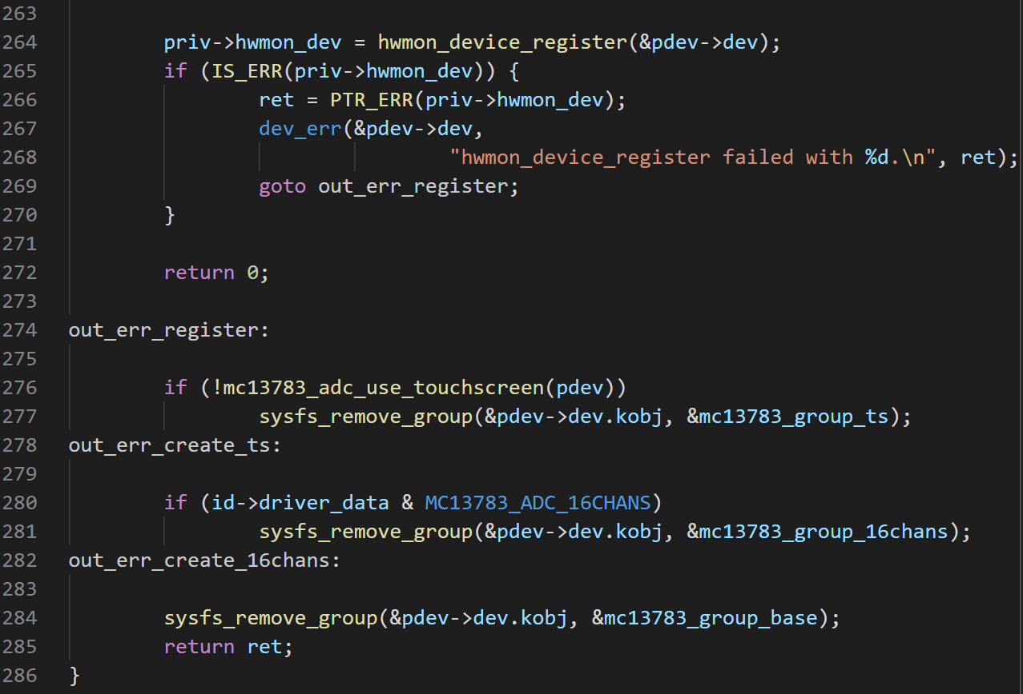
Goto

Slide 40
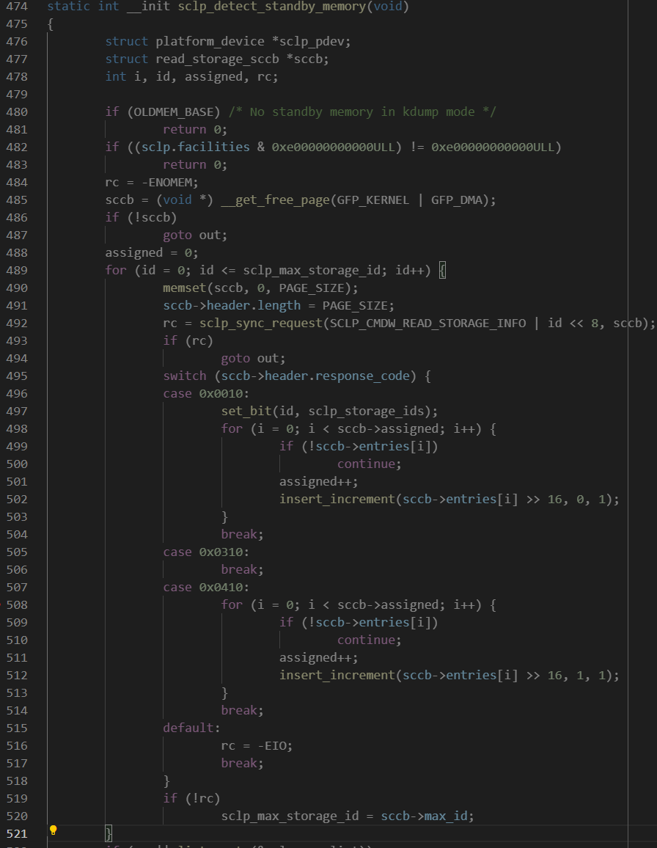
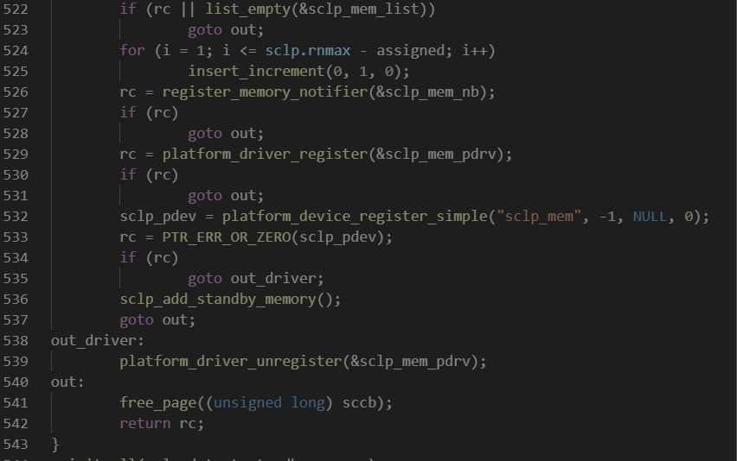
Nested

Slide 41
5. Stack and Heap

Slide 42
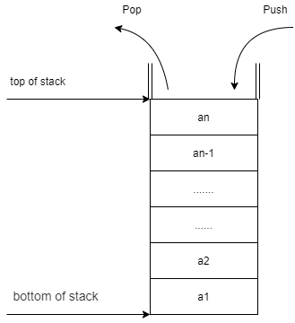
Stack and Heap
Stack:
Save local variables. The contents of the stack only exist inside the function. When the function finishes, the contents of the stack are automatically destroyed. It is characterized by high efficiency, but limited space
Heap：
The lifecycle is determined by the programmer, persists until the program ends without release. Flexible use, the space is relatively large, but the efficiency is relatively low.

Slide 43
Stack and Heap
1、 Storage content
2、management type
3、space size
4、 fragmentation
5、 growth direction
6、 allocation and release
7、 efficiency
Refer to: https://blog.csdn.net/weixin_31663397/article/details/112737118

Slide 44
Stack and Heap
Stack:
Overflow
Heap:
memory corruption
memory leakage

Slide 45
6. Function execution

Slide 46
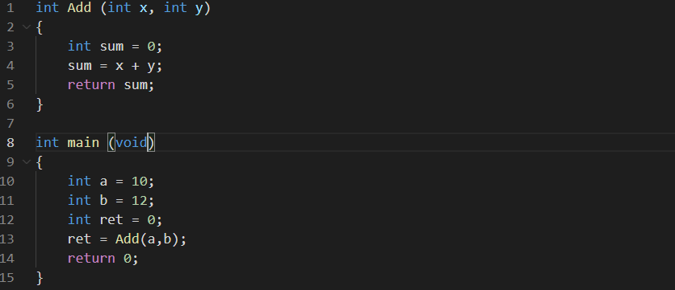
Function execution

Slide 47
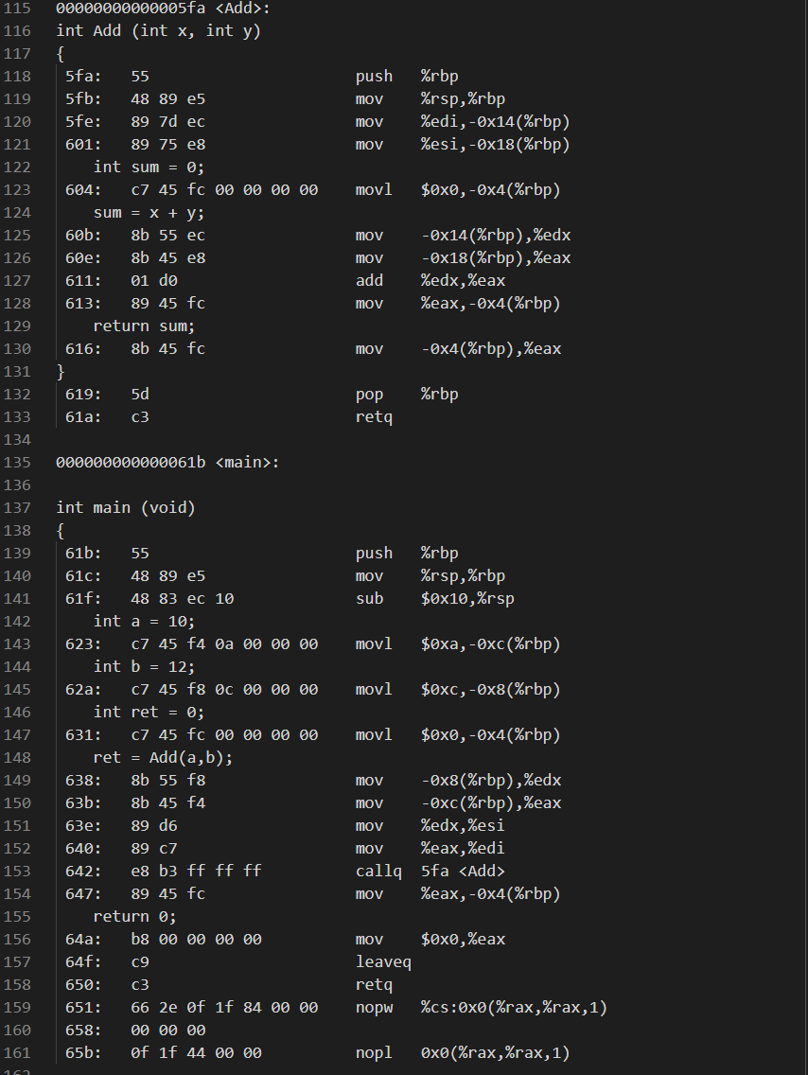
Function execution
64Bits PC
gcc -g -o main main.c
objdump -S -d main > main.txt
Register | 32Bits | 64Bits
Accumulator register | EAX | RAX
base register | EBX | RBX
counter register | ECX | RCX
data register | EDX | RDX
Stack base pointer | EBP | RBP
index register | ESI | RSI
Top of stack pointer | ESP | RSP
instruction register | EIP | RIP

Slide 48
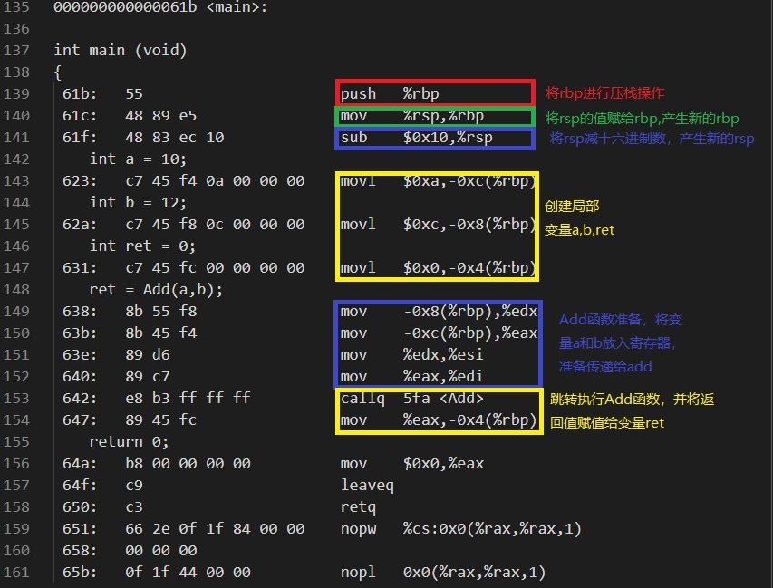
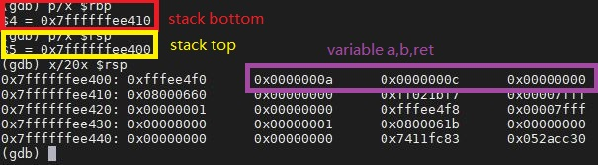
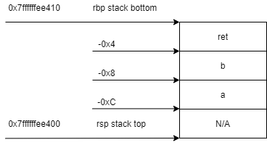
Function execution

Slide 49
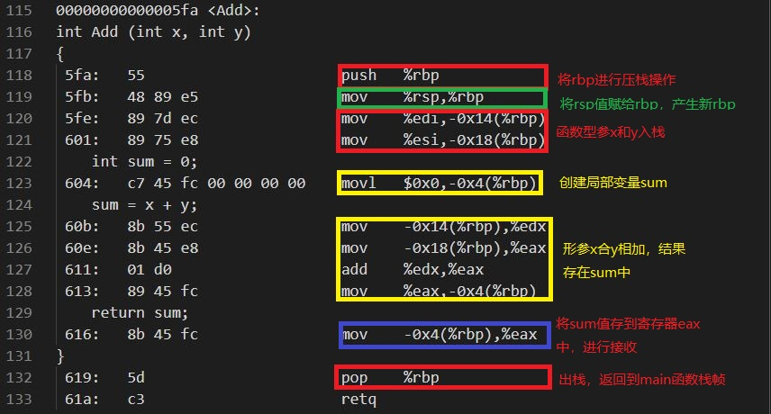
Function execution

Slide 50
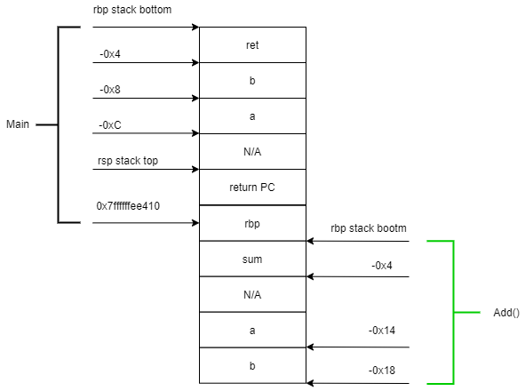
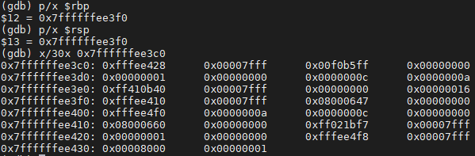
Function execution

Slide 51
?
Problems

